Slide 1




NEXT GEN EMPLOYABILITY PROGRAM
Creating a future-ready workforce
Team Members
College Name
Student Name : Arshitha J
Student ID : au960221104026
Arunachala College Of Engineering For Women

Slide 2

CAPSTONE PROJECT SHOWCASE
Project Title
Car Rentals Application with Django Framework
Abstract | Problem Statement | Project Overview | Proposed Solution | Technology Used | Modelling & Results | Conclusion

Slide 3
Abstract
The project introduces a sophisticated car rental application developed with Django framework, HTML, CSS, Python, Bootstrap, and JavaScript. It offers a wide range of templates for a comprehensive user experience, including dashboard, login, register, car details, search, cars, account, about, home, and services. Customers can effortlessly browse, reserve, and manage vehicles, with integrated login and registration ensuring secure access. Bootstrap ensures responsive design for various devices, while JavaScript enhances interactivity with features like real-time search and interactive car details. Administrators benefit from a versatile dashboard for efficient management of listings, accounts, and bookings. Leveraging Django's architecture and modern web technologies, the application delivers a user-friendly, scalable, and feature-rich solution for the car rental industry.
Source :

Slide 4
Problem Statement
To develop a robust car rental application using the Django framework, addressing the inefficiencies and challenges faced by both customers and administrators in the car rental industry.
The current system lacks a centralized platform for users to easily browse available cars, make reservations, and manage bookings, leading to fragmented experiences and potential security vulnerabilities.
Additionally, administrators struggle with manual processes for managing car listings, user accounts, and reservations, resulting in inefficiencies and errors.
Source :

Slide 5
Project Overview
The project involves the development of a comprehensive car rental application using the Django framework, HTML, CSS, Python, Bootstrap, and JavaScript. The application aims to streamline the car rental process for both customers and administrators by providing a user-friendly interface and efficient management tools.
For customers, the application will offer features such as:
Car Search and Reservation
Account Management
Responsive Design
Secure Authentication
For administrators, the application will provide features such as:
Dashboard
Car Listing Management
User Account Management
Booking Management
Source :

Slide 6
Proposed Solution
.
The proposed solution involves the development of a comprehensive car rental application utilizing the Django framework, along with HTML, CSS, Python, Bootstrap, and JavaScript.
The application will feature a range of templates including dashboard, login, register, car details, search, cars, account, about, home, and services, ensuring a seamless and intuitive user experience.
The booking process will be streamlined with real-time availability updates and dynamic search capabilities, while responsive design using Bootstrap will ensure compatibility across various devices.
Secure authentication mechanisms will safeguard user accounts and personal information, ensuring peace of mind for customers.
On the administrative side, a centralized dashboard will empower administrators to manage car listings, user accounts, and bookings efficiently.
Source :

Slide 7


Technology Used
Front-end
Back-end
Source :

Slide 8
Modelling & Results
The car rental application is a fully functional web platform that offers a seamless experience for both customers and administrators. Users can easily browse available cars, make reservations, and manage their accounts, while administrators have access to a centralized dashboard for efficient management of listings, accounts, and bookings. The application features responsive design, intuitive interfaces, and secure authentication mechanisms to ensure a smooth user experience. Advanced features such as real-time availability updates, dynamic search capabilities, and integration with a payment gateway enhance the functionality of the application. Overall, the result is a scalable, efficient, and user-centric solution that enhances the car rental experience for all stakeholders.
Source :

Slide 9
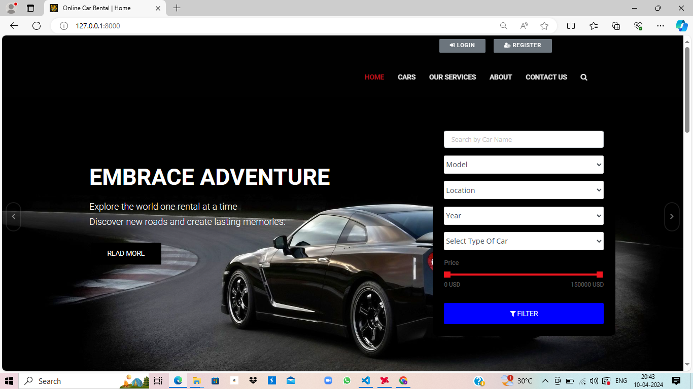
Homepage

Slide 10
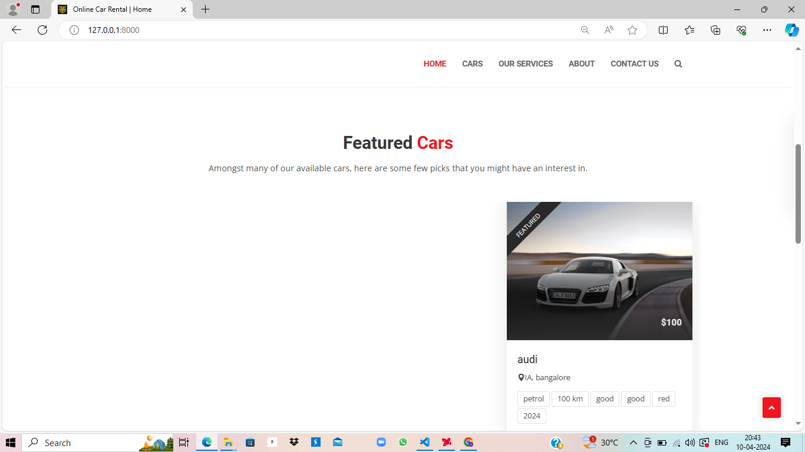
Homepage

Slide 11
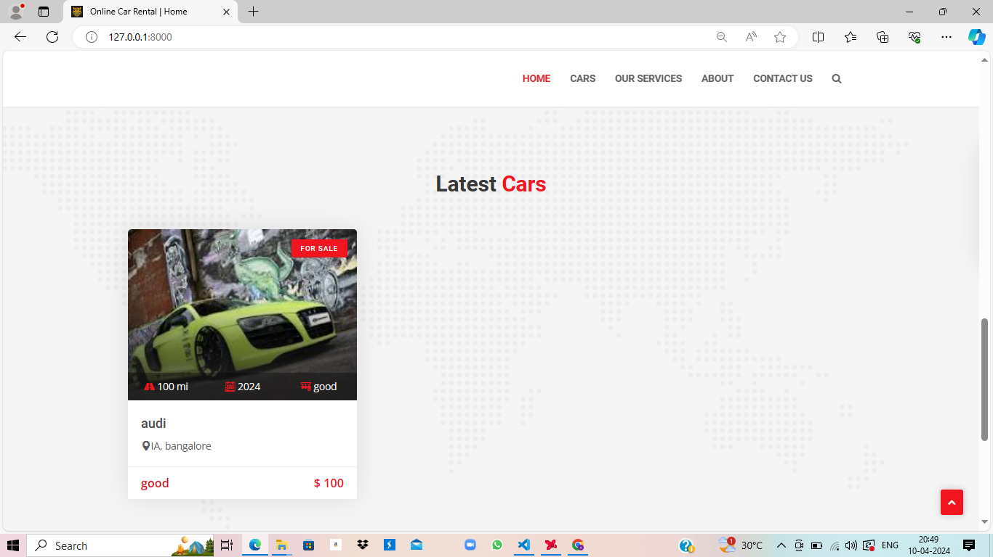
Homepage

Slide 12
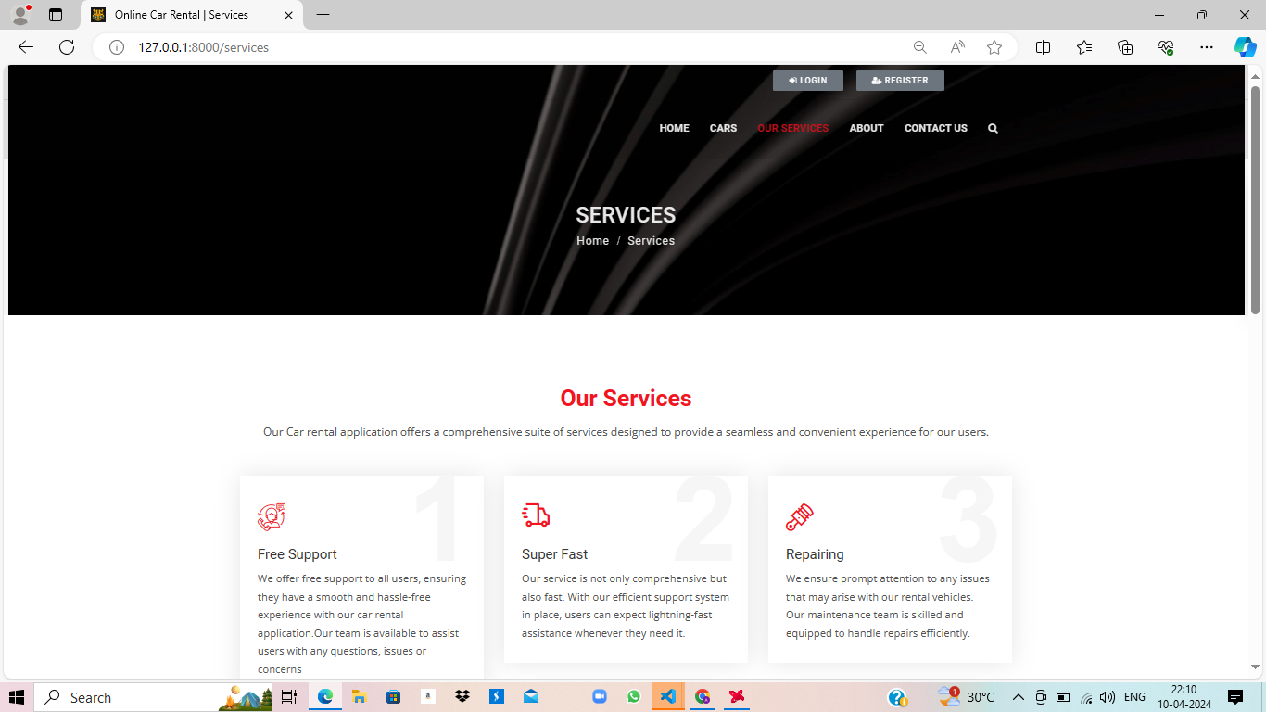
Service-Page

Slide 13
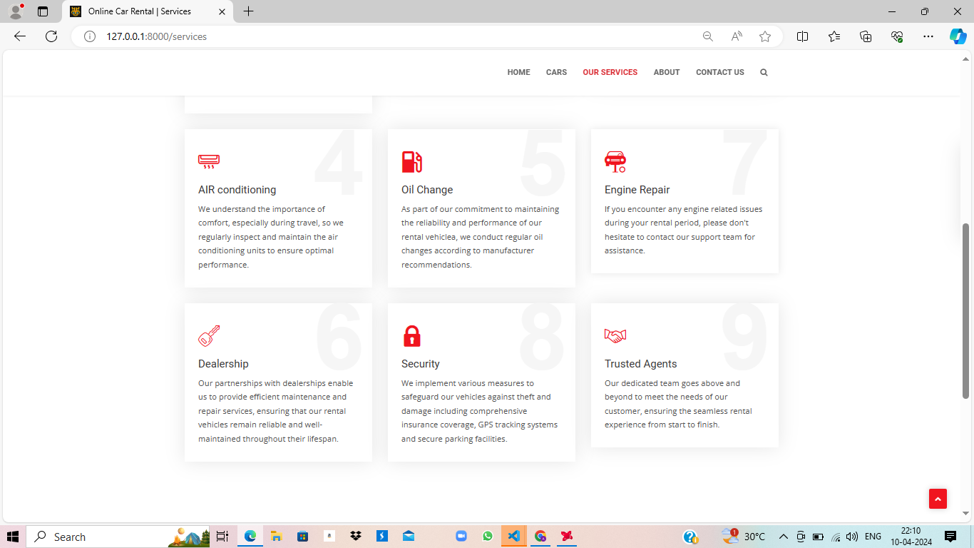
Service-Page

Slide 14
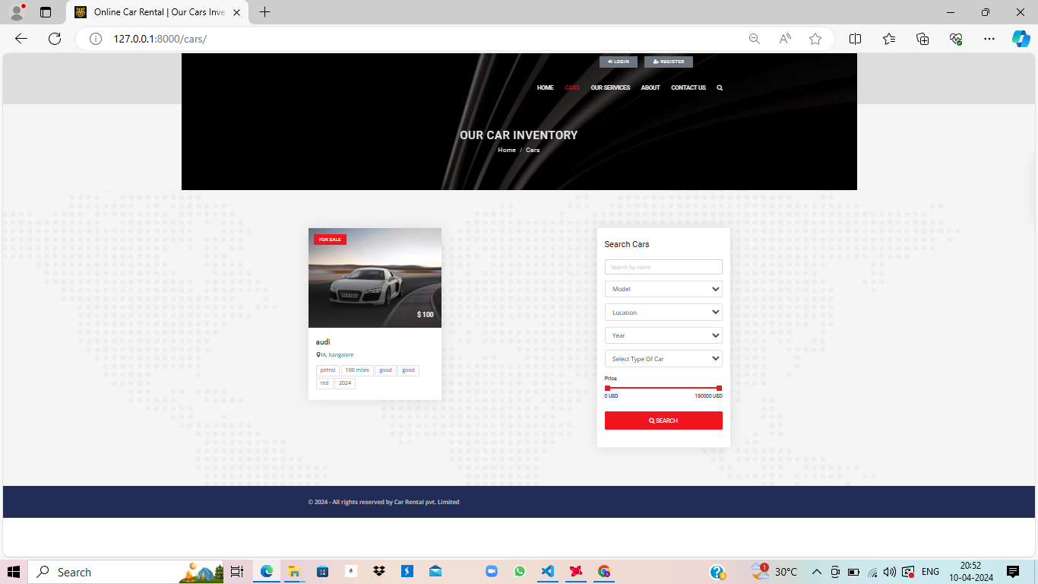
Car-Page

Slide 15
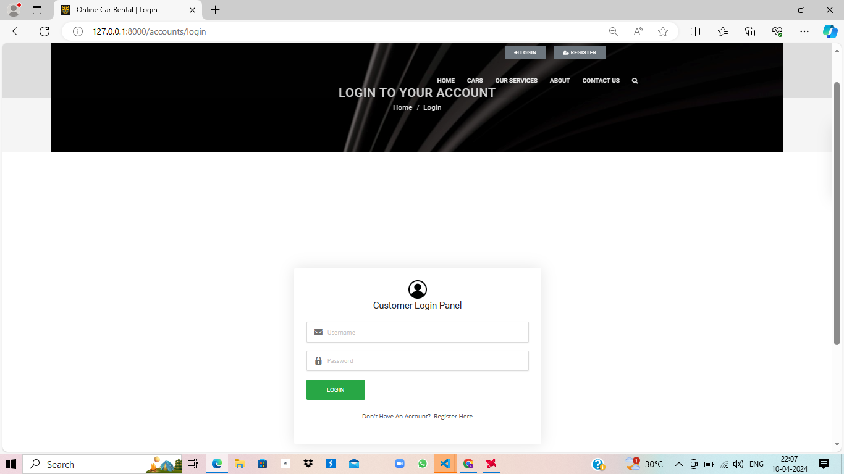
Login-Page

Slide 16
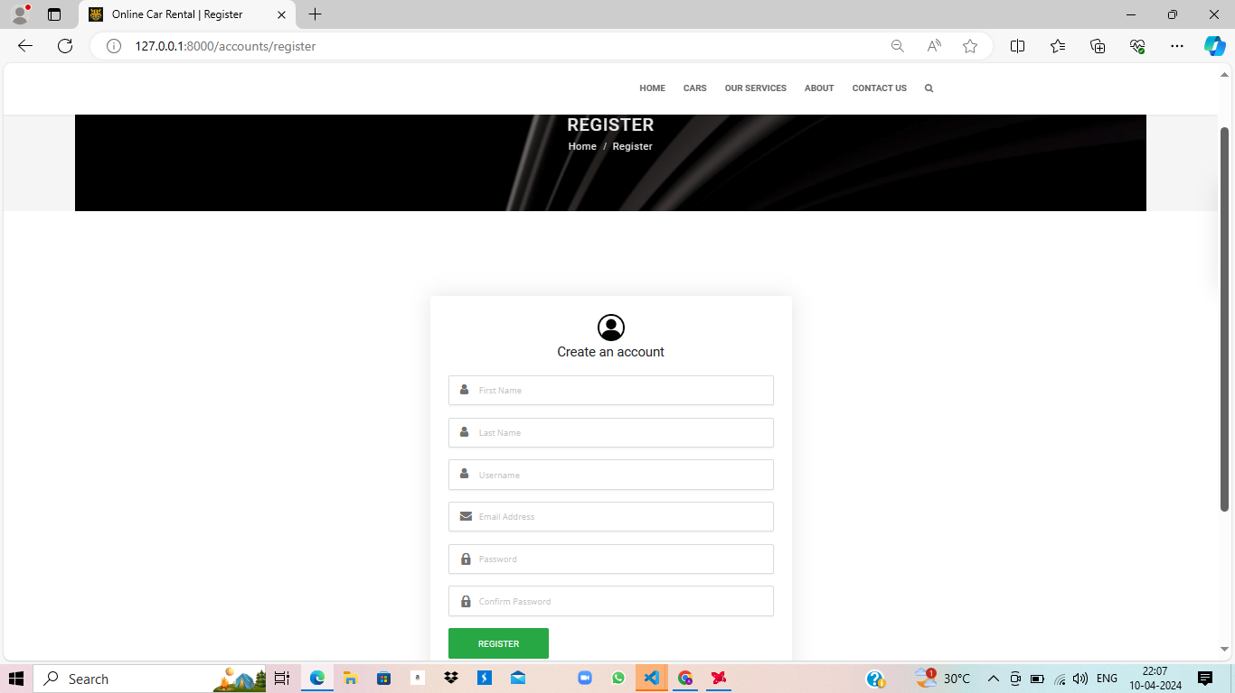
Register-Page

Slide 17
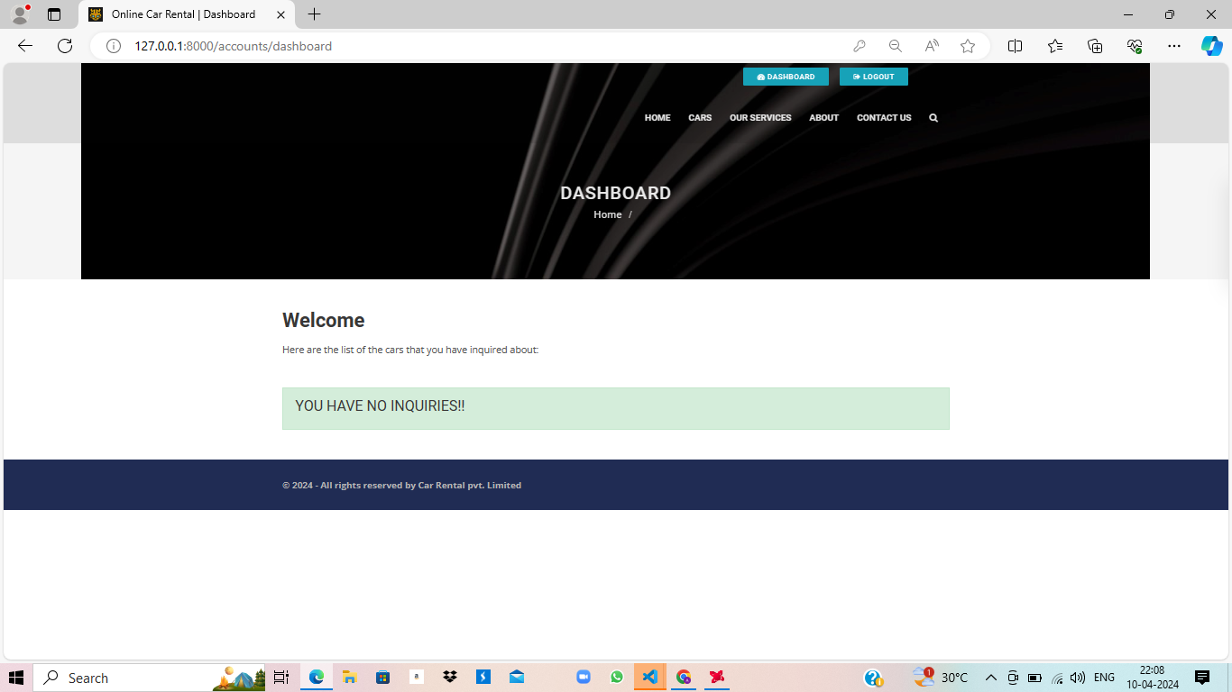
Dashboard-Page

Slide 18
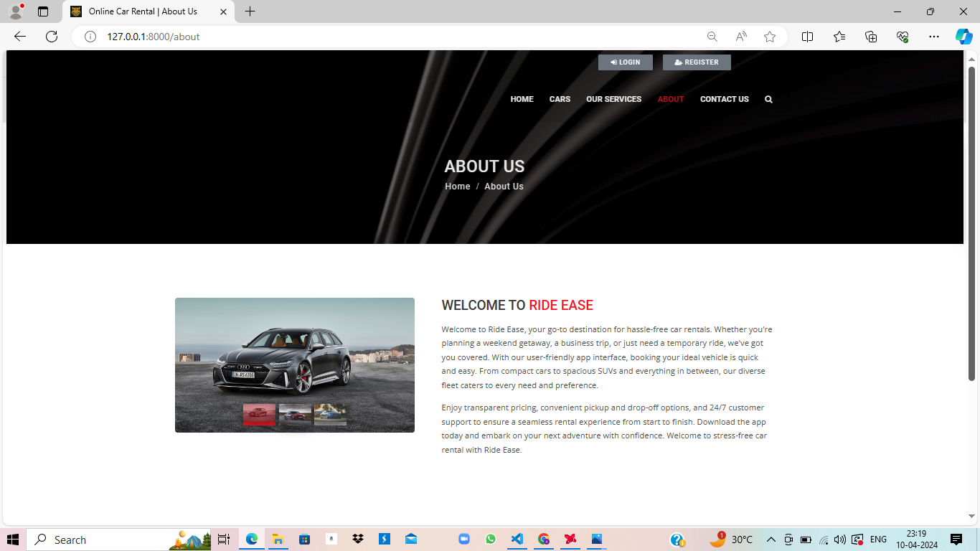
About-Page

Slide 19
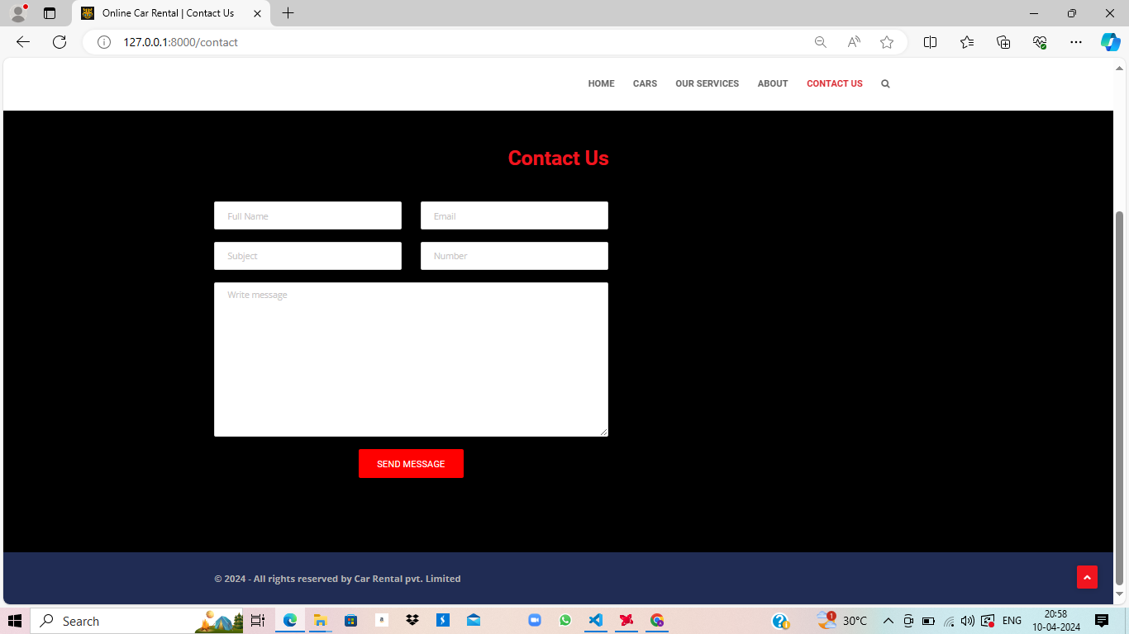
Contact-Page

Slide 20
Future Enhancements:
Implement a feature allowing users to rate and review their rental experiences, providing valuable feedback to both other users and administrators.
Enhance the search functionality by adding advanced filters such as car features, specifications, and user preferences to help users find their desired vehicles more efficiently.
Introduce a notification system to alert users about upcoming reservations, important updates, or special promotions, enhancing communication and user engagement.
Integrate a secure payment gateway to support various payment methods like Gpay, PhonePe, Net Banking, offering users convenience and flexibility during the booking and payment process.
Expand the application's services by incorporating additional features such as car maintenance scheduling, roadside assistance booking, or even partnerships with local businesses for additional amenities or services.

Slide 21
Conclusion
The "Car Rental Application" successfully addresses the challenges of the car rental industry by providing a user-friendly platform for seamless browsing, reservation, and management. With its robust backend powered by Django and intuitive frontend interface, the application enhances user experience while ensuring data security and integrity. The project's adaptability and scalability lay a strong foundation for future enhancements and integrations. Overall, the implementation of comprehensive testing, successful deployment, and ongoing maintenance reaffirms the application's reliability and efficiency, making it a valuable asset for both users and rental agencies in the ever-evolving landscape of car rental services.
Source :

Slide 22
Thank You!
Notes:
Thank You !!

